Slide 1
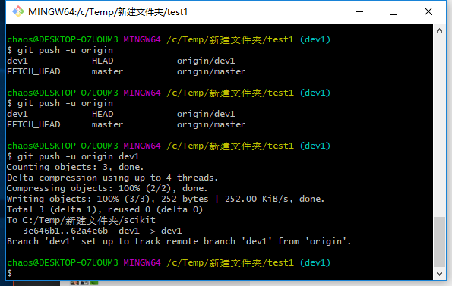
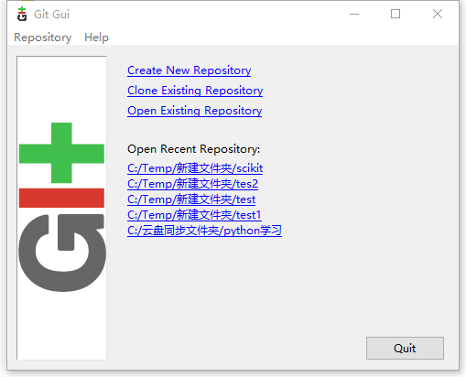
Download Git：https://git-scm.com/download/win
BASH
GUI

Slide 2
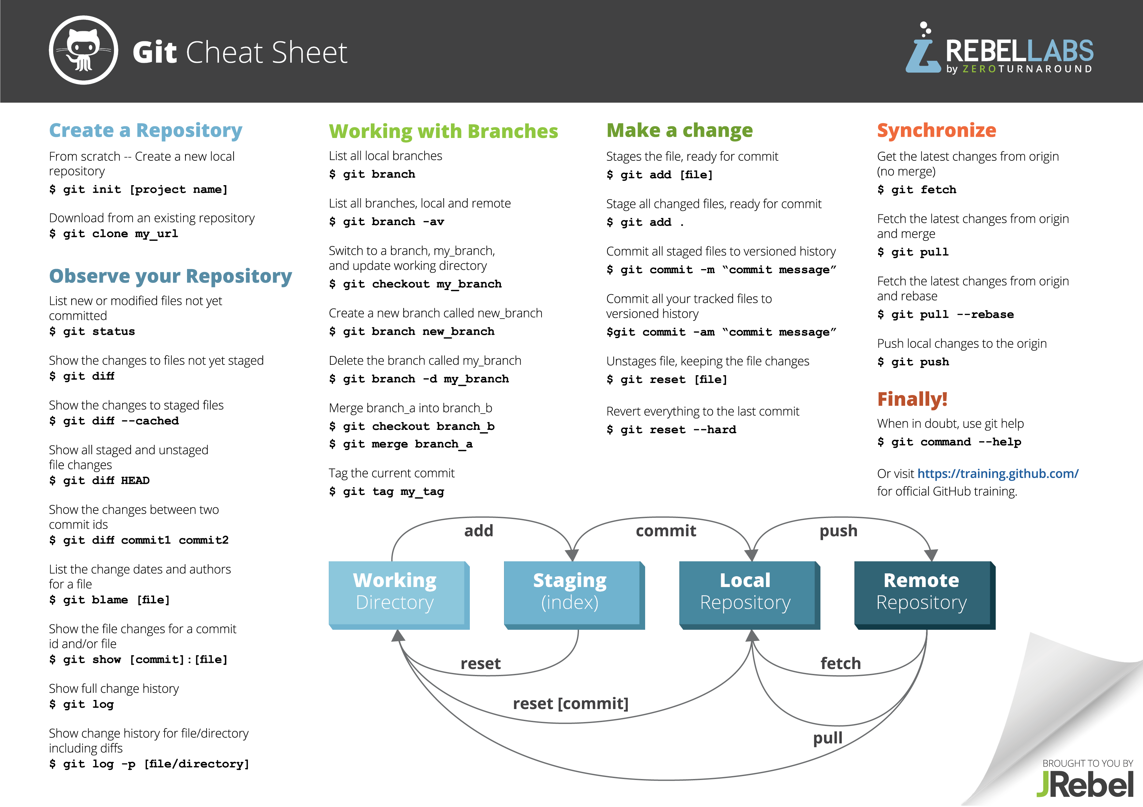

Slide 3

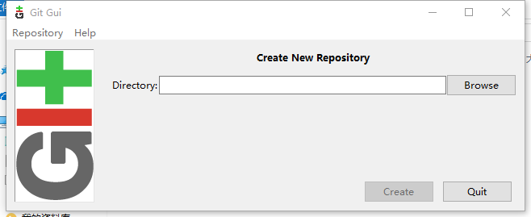
$ git config --global user.name "superGG1990"
$ git config --global user.email "superGG1990@163.com"
Creat Repository
selecting dir. to create repository
Bash: git init dir

Slide 4
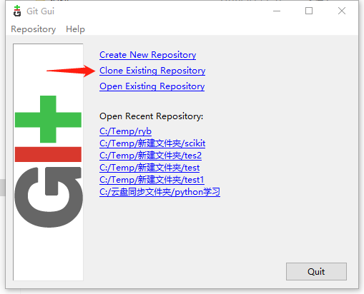
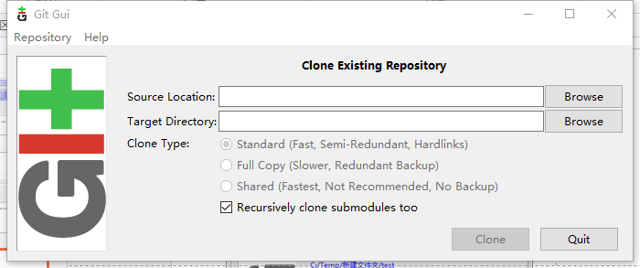
Clone Repository
Bash: git clone source_location target_location

Slide 5
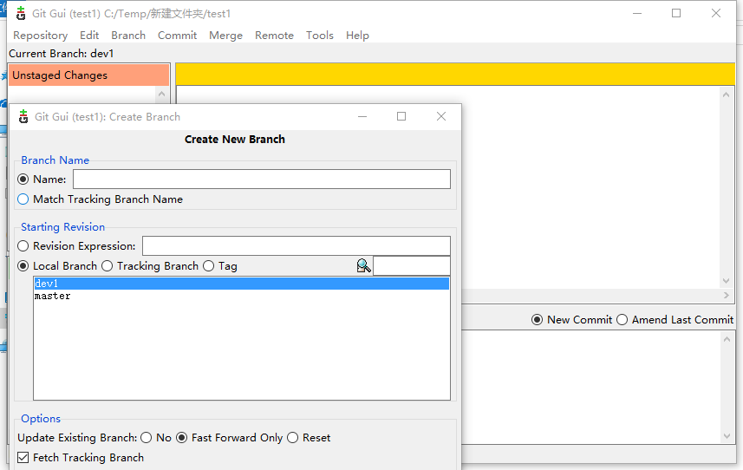
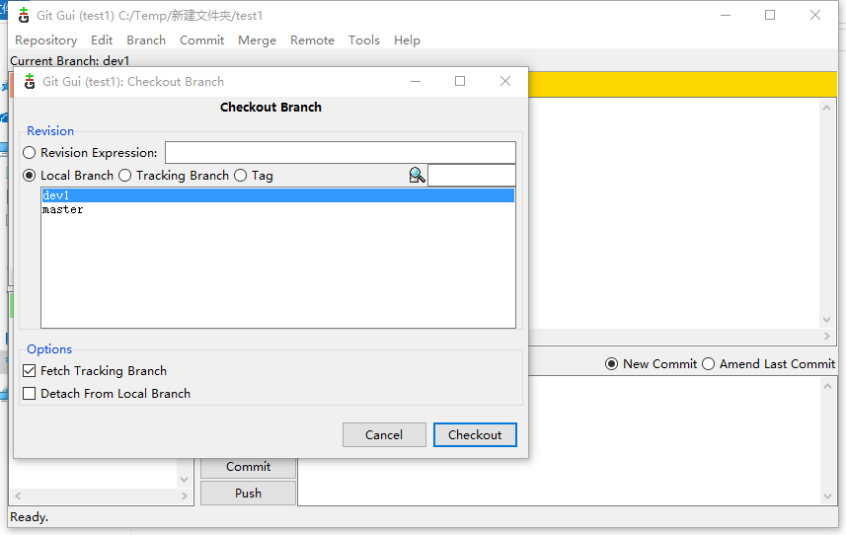
Create Branch
Caution: Master branch should be always protected to avoid being modified by user.
User can create a personal branch or checkout other user’s branch to modify program.
Creat branch
Checkout local branch or tracking branch(source repository)
Bash: git branch branch_name
Bash: git checkout branch_name

Slide 6
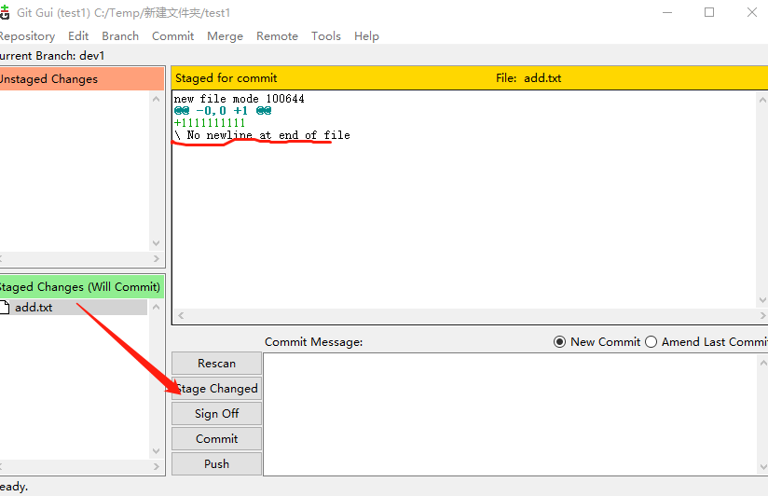
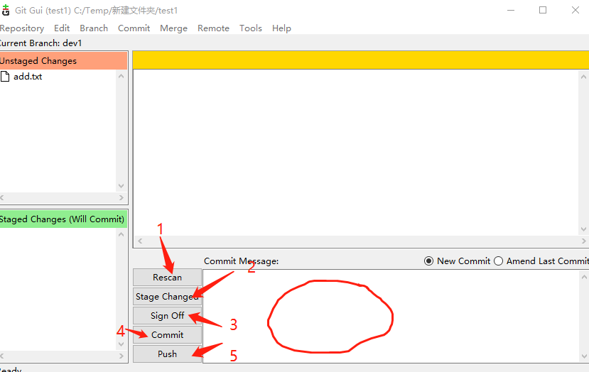
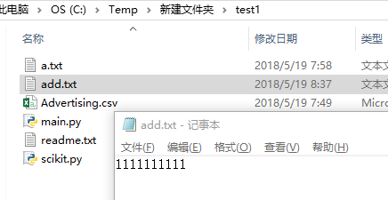
Add a file in repository
1. Add “add.file” to repository
Commit message must be filled，
And “Sign off” can be ignored!
File modify log
Bash: git add file_name(or –A ) –A all modified files
git commit –m ‘message’
git push (first time append “-u repo_name branch_name”)

Slide 7
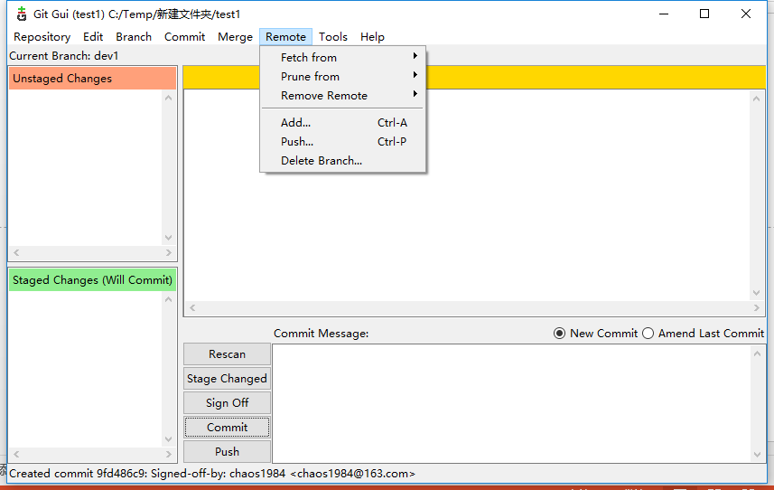
Update local repo. from source repo
If source repo is update, user also update local repo.
Bash: git fetch repo_name brach_name(recommend)
git pull repo_name brach_name

Slide 8
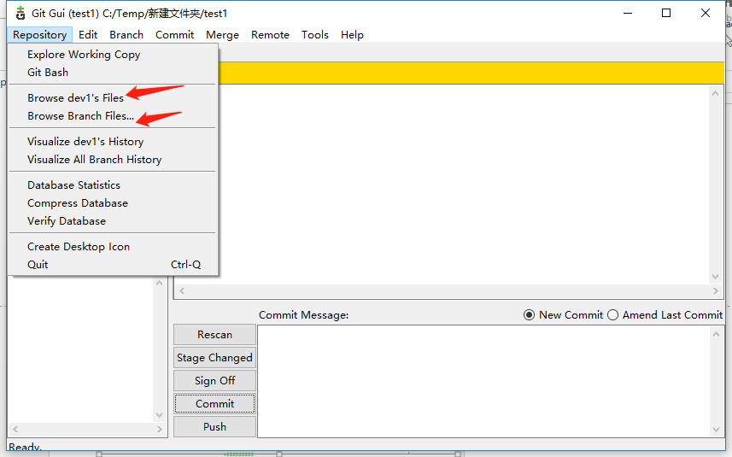
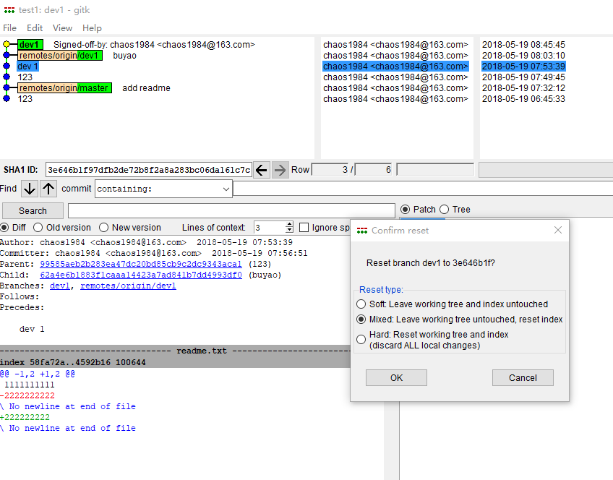
Reset current HEAD to the specified state
Previous version: git reset --hard HEAD^
Specify version: git reset --hard HEAD~version_num
Caution: HARD is dangerous!

Slide 9
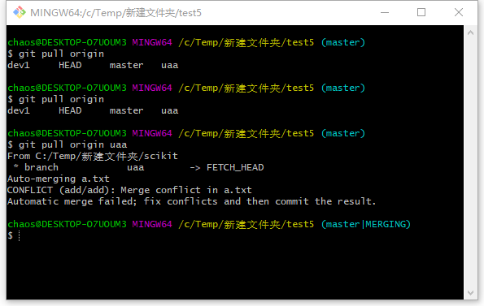
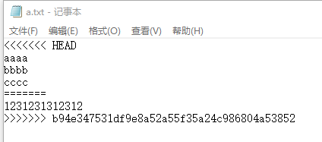
CAUTION :Files conflicts

Slide 10
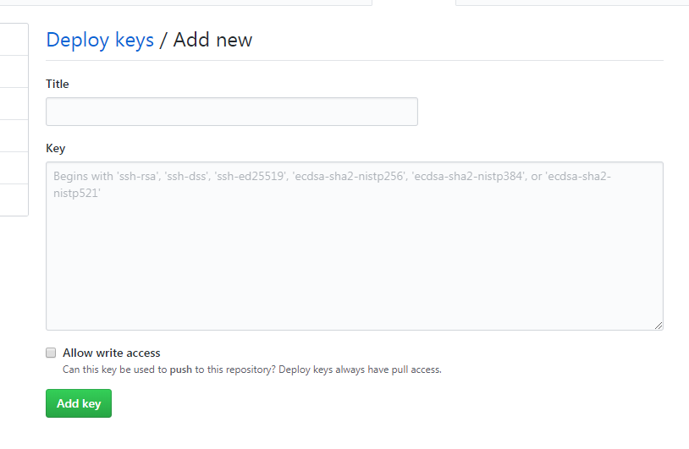
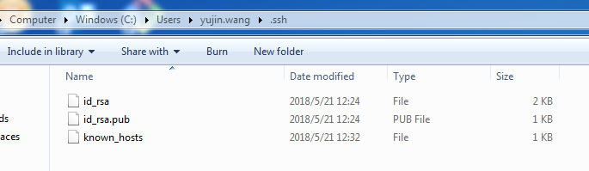
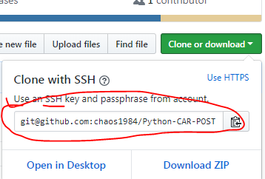
Github Configure
1.ssh-keygen
Run git
ssh-keygen -t rsa “user@mail” (reference :p1 )
2. Open id_rsa.pub
4.Github->settings->Dploy keys->fill the ‘Titile’ and add ssh key to ‘Key’
If user want to get write right ,please check the ‘Allow write access’
3.Clone repo with ssh
Copy the ssh keys
5. Git clone SSH KEYS
5. Done

